Slide 1
The ECC in practice, its structure, its routine
CEPT Workshop on European Spectrum Management and Numbering
4th June 2014

Slide 2
Scope
ECC: its framework
ECC: its organisation
ECC Deliverables
ECC Work Items
Participation to the ECC
ECC communications

Slide 3
ECC: What we do
Work towards common regulatory policies in Europe
Harmonise efficient use of the radio spectrum, satellite orbits and numbering resources
Develop European common positions and proposals, for use in the framework of ITU-R (WRC) to promote the European interests on a worldwide basis
Maintain a level of technical expertise.
Provide a focal point for information (EFIS etc.)
Cooperation with other bodies
http://www.cept.org/ecc
http://cept.org/ecc/who-we-are/what-we-do

Slide 4
ECC: framework
Rules of Procedure:
High level rules on the structure, the participation, chairmanships, documentation, organisation of meetings
Mechanism for ECC Decisions (development, approval, implementation, review...)
Principles for conduct of meeting: general rule is consensus (don’t imply unanimity). Voting on an exceptional basis (Plenary, WG)
Working Methods
Details further the general rules of the RoP
Rules for the participation of observers
Mechanisms for ECC Recommendations, ECC Reports and CEPT Reports

Slide 5
ECC: framework
Electronic working arrangements
enhance meeting participation and efficiency.
Guidelines on the organisation and participation in web-meetings, webinars, virtual participation in meetings.
Addresses also electronic features provided by the CEPT portal.
ECC strategic plan for 2010-2015
Expertise in managing scarce resources
Europe wide forum for the work in ITU (Radio sector)
Cooperation with the European Commission, ETSI, others…
Focal point in Europe for information on electronic communication
Identifies challenges in spectrum management and numbering
http://www.cept.org/ecc/framework

Slide 6
ECC: organisation
Electronic
Communications Committee
Chairman: E. Fournier (F)
Vice-Chairmen: J. Afonso (POR)
S. Pastukh (RUS)
Steering Group
European
Communications Office
Director: M. Thomas (G)
Deputy Director: B. Espinosa (F)
WG CPG
WG FM
WG SE
WG NaN
ECC PT1
ECC TG6
Conference
Preparatory Group
Frequency
Management
Spectrum
Engineering
Numbering
and Networks
IMT-Matters
Long Term Vision UHF
Chairman:
A. Kühn (D)
Vice-Chairman:
G. Osinga (HOL)
T: Azzarelli (G)
Chairman:
T. Weilacher (D)
Vice-Chairmen:
C. Reis (POR)
S. Talbot (G)
Chairman:
K. Loew (D)
Vice-Chairmen:
J. Duque (POR)
K. Bejuk (CRO)
Chairman:
J. Vallesverd
(NOR)
Vice-Chairman:
S. Gemming (D)
Chairman:
D. Chauveau (F)
Vice-Chairmen:
P. Toivonen (FIN)
S. Green (G)
Chairman:
Jaime Afonso (POR)

Slide 7
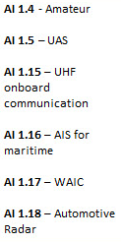
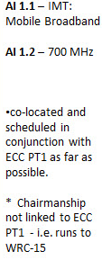
ECC: organisation WG CPG
CPG
Chairman: Alexander Kühn (DE)
Vice-Chairmen: Gerlof Osinga (NL)
Tony Azzarelli (G)
prepare European positions for
ITU World Radiocommunication Conferences (WRCs) and Radiocommunication Assemblies (RAs)
CPG PTA
Tony Azzarelli (G)
CPG PTB
Alexandre Vallet (FR)
Victor Glushko (RUS)
CPG PTC
Gerlof Osinga (NL)
CPG PTD
Didier Chauveau (FR)

Slide 8
ECC: organisation WG FM
Developing strategies, plans
and implementation advice
for the management of the
radio spectrum
WGFM
Working Group Frequency Management
Chairman: Thomas Weilacher (D)
Vice Chairman: Cristina Reis (POR)
Vice Chairman: Stephen Talbot (UK)
FM22 – Spectrum Monitoring and
Enforcement
Chairman: Ralf Trautmann (D)
FM44 – Satellite Communications
Chairman: Amar Saidani (F)
FM48 – Broadband Direct-Air-to-Ground
Communications (DA2GC)
Chairman: Alexey Shurakhov (RUS)
FM54 – Private/Professional Land Mobile
Systems/ esp. for Railways
Acting Chairman: Laurent Bodusseau (F)
WGFM Correspondence Groups
2 GHz Unpaired Bands: Chairman - Cristina Reis (POR)
BB-Maritime Links: Chairman - Eirik Bliksrud (N)
1452-1492 MHz: Benoist Deschamps (F)
FM49 – Radio Spectrum for Public
Protection and Disaster Relief (PPDR)
Chairman: Laurent Bodusseau (F)
FM55 – 5 GHz WAS/RLAN
Chairman: Andrew Gowans (UK)
FM51 – PMSE Chairman: Lindsay Cornell (UK)
FM Maritime FG
WGFM Maritime Forum Group
Chairman: Jaap Steenge (NL)
SRD/MG
Short Range Devices
Maintenance Group
Chairman: Thomas Weber (ECO)
FM52 – 2300-2400 MHz Chairman: Bruno Espinosa (ECO)
FM Radio Amateur FG
WGFM Radio Amateur Forum Group
Acting Chairman: Thomas Weber (ECO)
EFIS/MG
ECO Frequency Information
System Maintenance Group
Chairman: Stefan Mayer-Bidmon (D)
FM53 – RRS and LSA
Reconfigurable Radio Systems and
Licensed Shared Access Chairman: Emmanuel Faussurier (F)

Slide 9
ECC: organisation WG SE
Developing technical guidelines and
sharing and compatibility arrangements
for radio spectrum use
by various radiocommunications services
STG – SEAMCAT
Technical Group
Chairman:
J-P Kermoal (ECO)
SE7 – Compatibility and sharing issues of
mobile systems
Chairman:
P. Jokela (FIN)
SE19 – Fixed Service
Chairman:
J-P Kermoal (ECO)
WGSE
Working Group
Spectrum Engineering
Chairman:
K. Loew (D)
Vice chairmen:
J. Duque (POR)
Vice chairmen:
K. Bejuk (HRV)
SE21 – Unwanted
Emissions
Chairperson:
M. Pavsek (SVN)
SE24 – Short Range
Devices
Chairman:
R. Kallenborn (D)
SE40 – Space Services
Compatibility Issues
Acting chairman:
S. Lyubchenko (ECO)
FG Ref.doc – Forum Group on Spectrum Engineering Reference Document
Convener:
J-P Kermoal (ECO)
FG Wind Turbines – Forum Group on Wind Turbines
Convener:
Hans Sundkvist (Sweden)

Slide 10
ECC: organisation WG NaN
Developing policies in numbering, naming and addressing and advising on technical regulatory matters to promote telecom innovation and competition
WG NaN
Numbering & Networks
Chairman: Johannes Vallesverd (NOR)
Vice-Chairman: Vacant
PT TRIS
PT FNI
PT NP
PT ES
Technical
Regulatory Issues
Future
Numbering Issues
Number
Portability
Emergency
Services
Chairman:
Daniel Voisard (SUI)
Chairman:
Francesco Bernabei(IT)
Chairman:
João Feijó Silva (POR)
Chairman:
Florin Dragomir
(ROU)

Slide 11
ECC Deliverables (1)
ECC Decisions
Aim at harmonisation in the electronic communications regulatory field:
“Designate" a frequency band for harmonisation matters.
Voluntary basis: Members implementing the Decision commit themselves
ECC Recommendations
Measures which administrations are encouraged to apply
Harmonisation measures for those matters where Decisions are not yet relevant or to provide guidance to national administrations

Slide 12
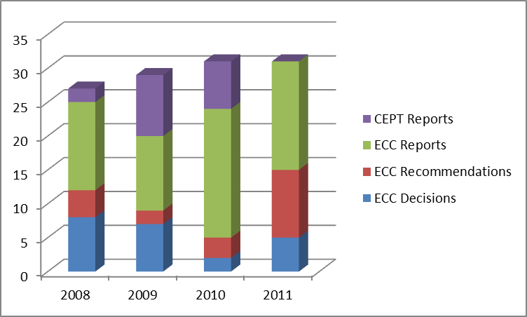
ECC Deliverables (2)
ECC Reports
Result of studies by the ECC normally in support of a harmonisation measure
CEPT Reports
Result of studies by the ECC in response to Mandates from the EC.

Slide 13
Flow of ECC Deliverables
Concensus on Draft
Decision
Recommendation
Report (ECC and
CEPT)
2 weeks
window for
Admin veto (*)
Public Consultation open for all
Project
Team
at least 6 weeks
Working
Group
Assessing
the comments
A veto returns
a Deliverable
back to a group
ECO
Analysis
Approval
Final
Deliverables
Publication
on ECO
Document
database
Project
Team
Working
Group
Working
Group
ECC
Plenary
http://www.ecodocdb.dk/
(*) Not applicable if approved for Public Consultation
by the ECC Plenary

Slide 14
ECC Deliverables
Decisions: approved for Public Consultation by WGs or the ECC Plenary. Final adoption by the ECC Plenary
Recommendations and Reports may be (unanimously) approved by WGs
CEPT Reports in response to EC Mandates approved by the ECC Plenary and sent to the EC

Slide 15
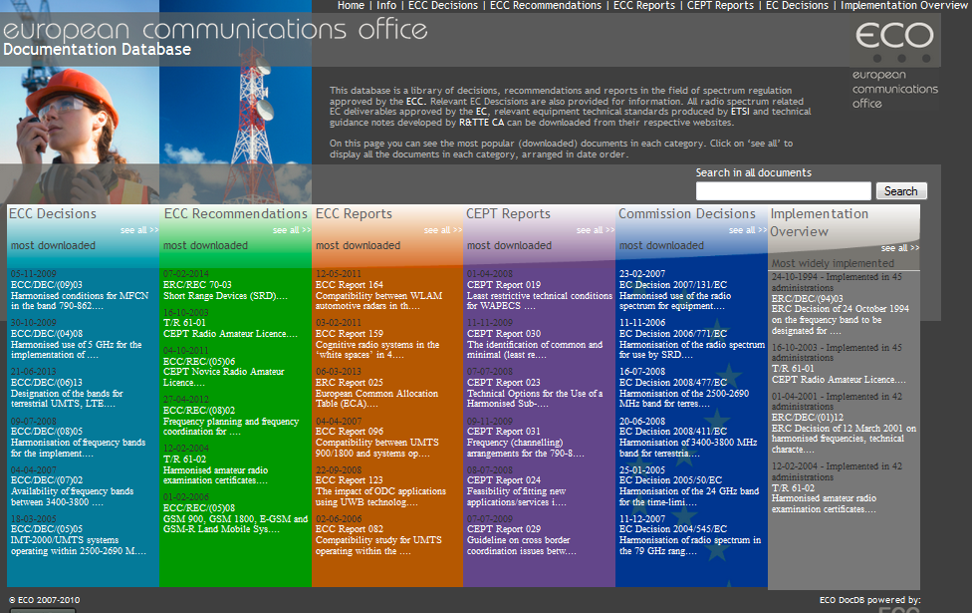
ECO DocDB (www.ecodocdb.dk)

Slide 16
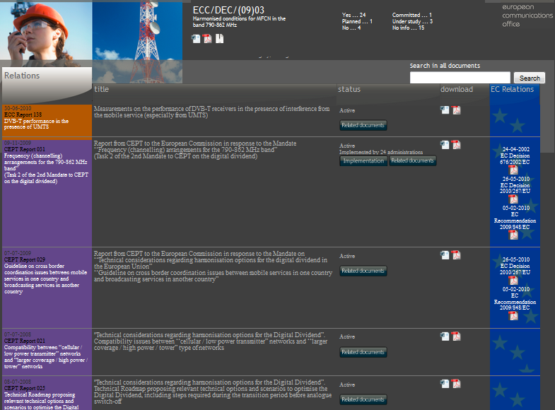
ECO DocDB

Slide 17
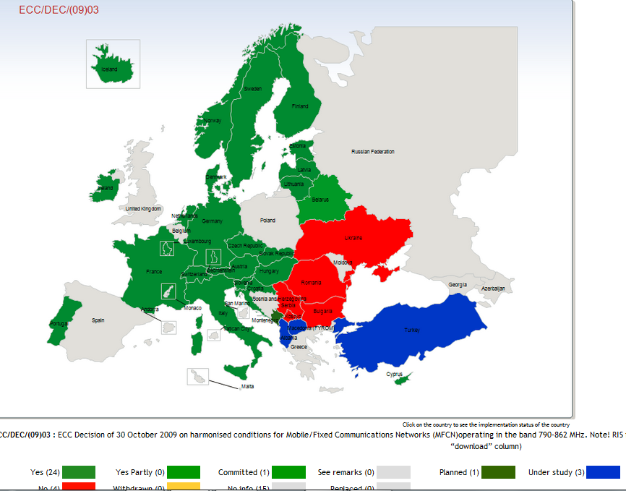
ECO DocDB - Implementation

Slide 18
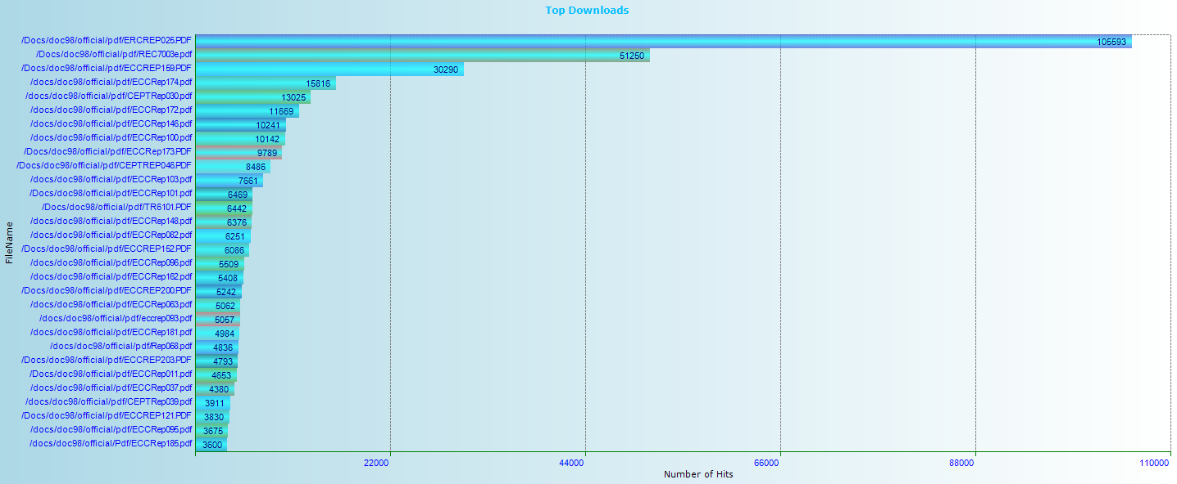
Top ECC deliverables download
European Common Allocation, Short Range Devices, Cognitive Radio, Digital Dividend, Mobile issues,...

Slide 19
ECC Work Items
ECC entities adopt Work Items which constitute the ECC Work Programme
Administrations (5 supporting administrations)
Industry (ETSI)
Exchanges of information between ECC and ETSI during the development of deliverables relating to spectrum management (http://www.cept.org/ecc/about-ecc/ecc-etsi)
Finalized Work Items usually result in ECC Deliverables and can be seen in ECO DocDB

Slide 20
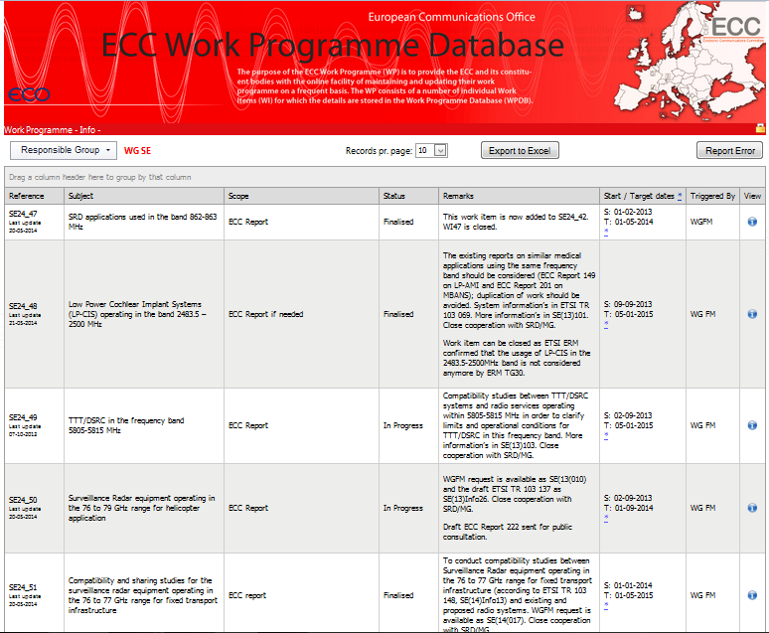
ECC Work Programme
http://eccwp.cept.org/

Slide 21
ECC Participation
Members of CEPT are Members of the ECC as of right
Representatives of the European Commission and of the European Free Trade Association Secretariat are Counsellors of the ECC
MoUs and LoUs with CEPT or specifically with ECC: more than 40 organisations
Representatives of relevant inter-governmental organisations as well as other organisations or non-CEPT administrations concerned with electronic communications may be invited by the relevant Chairmen to participate as Observers in their meetings on an ad-hoc basis

Slide 22
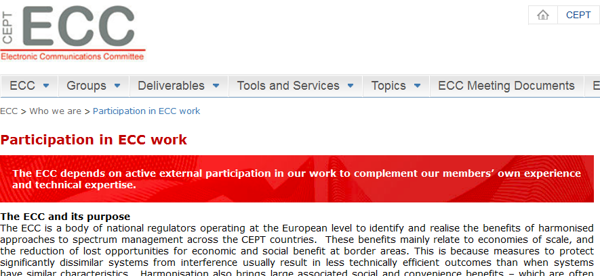
ECC’s external participation
The ECC depends on active external participation in our work to complement our members’ own experience and technical expertise.
Observers can participate in the ECC meetings when issues of mutual interest are placed on the agenda
http://www.cept.org/ecc/who-we-are/participation-in-ecc-work

Slide 23
ECC Communications
ECC Newsletters: http://cept.org/ecc/who-we-are/ecc-newsletters . 3-4 per year. Keep up-to-date with important spectrum and numbering policy issues being considered within the ECC.
News releases on the website.
Publication of monthly news summary to find out what's been going on in our Working Groups and Project Teams
Publication of presentations made by key ECC figures at conferences and workshops.
The ECC is on Twitter https://twitter.com/CEPT_ECC

Slide 24
Thanks for your attention!!

